Slide 1


MinMax Sampling: A Near-optimal Global Summary
for Aggregation in the Wide Area
Yikai Zhao, Yinda Zhang, Yuanpeng Li, Yi Zhou, Chunhui Chen,
Tong Yang, Bin Cui
Peking University, China
SIGMOD 2022, June 12–17, 2022
Philadelphia, PA, USA.
Notes:
Hi everyone, I am Yikai Zhao from Peking University. My presentation today is about our paper "MinMax Sampling: A Near-optimal Global Summary for Aggregation in the Wide Area".

Slide 2

01
Part One
Background
Notes:
Let's start with the background.

Slide 3
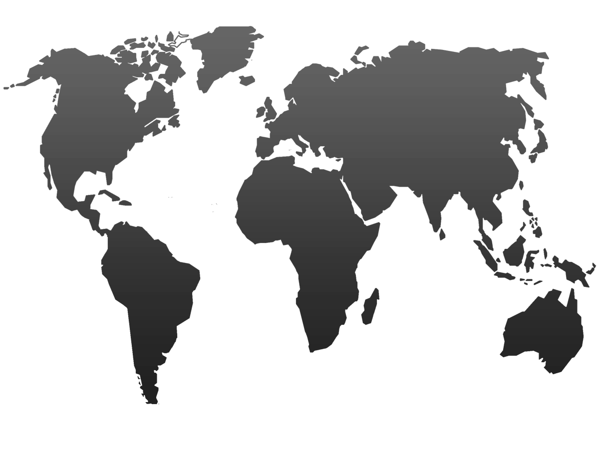



Geo-Distributed Systems - Wide-area Data Analyses & Wide-area Data Analyses
Wide-area Data Analyses are pervasive with emerging geo-distributed systems
CDN (Content Distribution Networks)
computing infrastructures
Wide-Area Streaming Analytics
JetStream
AWStream
Device 1
Device 2
Device 7
Device 3
Coordinator
Device 6
Device 4
Device 6
Device 5
Notes:
Nowadays, wide-area data analyses and streaming analytics are pervasive with emerging geo-distributed systems. Some computing infrastructures often generate large volumes of data on geographically distributed devices across the globe.

Slide 4
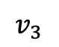
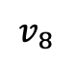
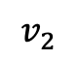
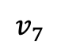
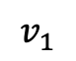
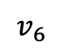
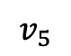
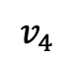
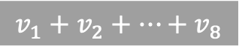
Global Aggregation in the Wide Area & Applications
Global Aggregation in the Wide Area
global synchronization
runtime monitoring
fault detection
Applications
Federated learning
Distributed state aggregation
Hierarchical aggregation
$$v_{1}$$
$$v_{2}$$
$$v_{8}$$
$$v_{3}$$
$$v_{1}+v_{2}+⋯+v_{8}$$
$$v_{7}$$
$$v_{4}$$
$$v_{6}$$
$$v_{5}$$
Notes:
Typically, there is a coordinator monitoring all devices. To get the global state to support better global synchronization, runtime monitoring, or fault detection, we need to perform global aggregation over the wide area, that is, collect the states from all distributed devices and aggregate them to get the global state.
Global aggregation occurs in many applications, including federated learning, distributed state aggregation, and hierarchical aggregation.

Slide 5
Federated learning, Distributed State Aggregation, Hierarchical Aggregation
Federated learning
local device: smartphones, laptops, IoT devices
coordinator: parameter server
transmitted data: model gradients
Distributed state aggregation
local device: distributed servers
coordinator: central analyzer
transmitted data: system event logs, object access logs
Hierarchical aggregation
Device 1
Device 2
Device 7
Device 3
Coordinator
Device 6
Device 4
Device 6
Device 5
Notes:
Federated learning is an important learning setting, in which the local devices are smartphones or IoT devices with models deployed, the coordinator is a parameter server, and the transmitted data are the gradients on each device.

Slide 6
Federated learning, Distributed State Aggregation, Hierarchical Aggregation
Federated learning
local device: smartphones, laptops, IoT devices
coordinator: parameter server
transmitted data: model gradients
Distributed state aggregation
local device: distributed servers
coordinator: central analyzer
transmitted data: system event logs, object access logs
Hierarchical aggregation
Device 1
Device 2
Device 7
Device 3
Coordinator
Device 6
Device 4
Device 6
Device 5
Notes:
Distributed state aggregation is necessary for distributed data services, in which the local devices are distributed servers, the coordinator is a central monitor, and the transmitted data are log files;
hierarchical aggregation typically occurs in networks with a hierarchical structure, in which the coordinator in one level may become a distributed device in the next level.

Slide 7
Challenge: Scarce and variable bandwidth
Local devices often connect to the central device through the wireless network or WAN
Scarce and variable bandwidth may degrade the aggregation performance
Available
Bandwidth
Transmitted
Federated learning : prolong the time of model training
Distributed state aggregation: increase the response delay of fault events
Notes:
Local and central devices are often connected to each other through the WANs or wireless networks, and the bandwidth is often scarce and variable.
When the volume of data transmitted exceeds the available bandwidth, the performance of the application will degrade. Insufficient bandwidth will prolong the training, or increase the response time to fault events.

Slide 8

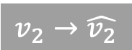

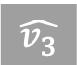
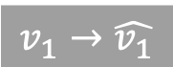
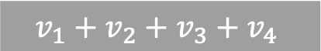

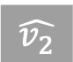
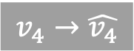

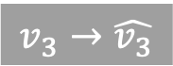
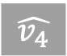
Communication Scheme: Fast Computation, Adaptive Transmission, Accurate Aggregation
Approximation is often needed!
Fast Computation
Adaptive Transmission
Accurate aggregation
$$v_{1}→\hat{v_{1}}$$
Device 1
Coordinator
$$\hat{v_{1}}$$
$$v_{2}→\hat{v_{2}}$$
Device 2
$$\hat{v_{2}}$$
$$\hat{v_{1}}+\hat{v_{2}}+\hat{v_{3}}+\hat{v_{4}}$$
$$v_{3}→\hat{v_{3}}$$
Device 3
$$\hat{v_{3}}$$
$$≈$$
$$\hat{v_{4}}$$
$$v_{4}→\hat{v_{4}}$$
Device 4
WAN
$$v_{1}+v_{2}+v_{3}+v_{4}$$
Notes:
Since the network has become the bottleneck, it is highly desired to design a communication scheme for global aggregation in WANs.
Specifically, a communication scheme can generate an approximate summary based on the state at local device, and transmit this local summary instead of the original state; the central device collects the local summaries from all devices, and computes a global summary to approximate the global state.
We have three design requirements for the communication scheme: fast computation, adaptive transmission, and accurate aggregation.

Slide 9
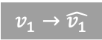
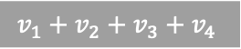
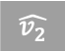

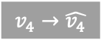

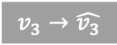
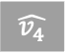

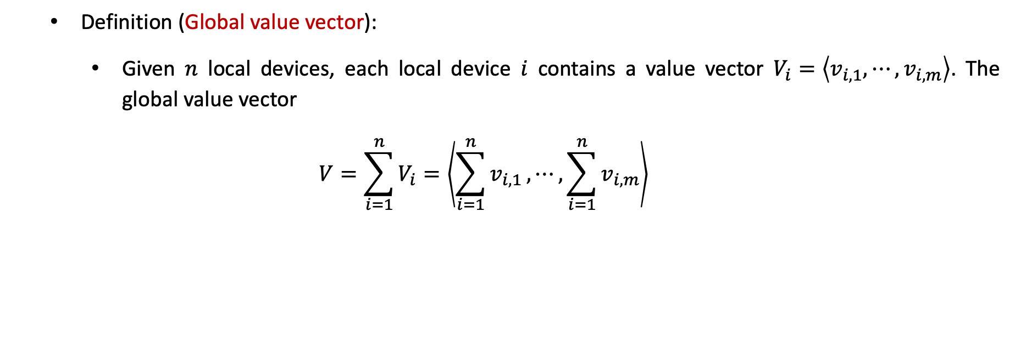
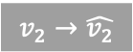
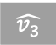
Global Value Vector & Sampling Model
Definition (Global value vector):
Given $n$ local devices, each local device $i$ contains a value vector $V_{i}=\left\langle v_{i, 1}, ⋯, v_{i, m}\right\rangle$. The global value vector
$$V=\sum_{i=1}^{n}{V_{i}}=\left\langle \sum_{i=1}^{n}{v_{i,1}}, ⋯, \sum_{i=1}^{n}{v_{i,m}}\right\rangle$$
Fast Computation
Adaptive Transmission
Accurate aggregation
$$v_{1}→\hat{v_{1}}$$
Device 1
Coordinator
$$\hat{v_{1}}$$
$$v_{2}→\hat{v_{2}}$$
Device 2
$$\hat{v_{2}}$$
$$\hat{v_{1}}+\hat{v_{2}}+\hat{v_{3}}+\hat{v_{4}}$$
$$v_{3}→\hat{v_{3}}$$
Device 3
$$\hat{v_{3}}$$
$$≈$$
$$\hat{v_{4}}$$
$$v_{4}→\hat{v_{4}}$$
Device 4
WAN
$$v_{1}+v_{2}+v_{3}+v_{4}$$
Notes:
More formally, the distributed system contains N local devices, where each device maintains a state that can be viewed as a vector Vi; and the global state is a global vector V, where each component is the sum of the corresponding components of all local vectors.

Slide 10
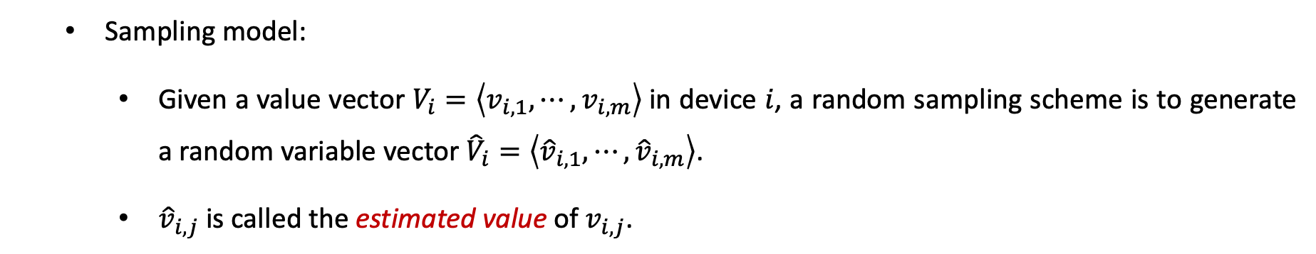
Global Value Vector & Sampling Model
Sampling model:
Given a value vector $V_{i}=\left\langle v_{i, 1}, ⋯, v_{i, m}\right\rangle$in device $i$, a random sampling scheme is to generate a random variable vector ${\hat{V}}_{i}=\left\langle {\hat{v}}_{i, 1}, ⋯, {\hat{v}}_{i, m}\right\rangle$.
${\hat{v}}_{i,j}$ is called the estimated value of $v_{i,j}$.
Fast Computation
Adaptive Transmission
Accurate aggregation
$$v_{1}→\hat{v_{1}}$$
Device 1
Coordinator
$$\hat{v_{1}}$$
$$v_{2}→\hat{v_{2}}$$
Device 2
$$\hat{v_{2}}$$
$$\hat{v_{1}}+\hat{v_{2}}+\hat{v_{3}}+\hat{v_{4}}$$
$$v_{3}→\hat{v_{3}}$$
Device 3
$$\hat{v_{3}}$$
$$≈$$
$$\hat{v_{4}}$$
$$v_{4}→\hat{v_{4}}$$
Device 4
WAN
$$v_{1}+v_{2}+v_{3}+v_{4}$$
Notes:
Sampling model defines an important class of communication schemes. Given a vector Vi on a local device, a random sampling scheme is to generate a random variable vector (hat) Vi, where (hat) vij is the estimated value. The scheme samples and transmits the components whose estimated values are non-zero.

Slide 11
Communication Scheme: Compression-based, Sketch-based, Sampling
NOT Fast ✗: Compression-based schemes
Large computational burden
NOT Adaptive✗: Sketch-based scheme
Require the size of sketches on all devices to be the same
NOT Adaptive✗: Unbiased sampling (H-sampling, Iceberg sampling)
Unable to customize the size of transmitted local summary
NOT Adaptive✗: Biased sampling (Top-𝐾 sampling)
Its error will increase linearly with the number of devices
Notes:
Although there are many schemes that can generate local summaries, there is no scheme can achieve three requirements simultaneously: schemes based on lossless compression allow perfect reconstruction after compression, but lossless compression brings a large computational burden, and the compression ratio cannot be flexibly customized.

Slide 12
Communication Scheme: Compression-based, Sketch-based, Sampling
NOT Fast ✗: Compression-based schemes
Large computational burden
NOT Adaptive✗: Sketch-based scheme
Require the size of sketches on all devices to be the same
NOT Adaptive✗: Unbiased sampling (H-sampling, Iceberg sampling)
Unable to customize the size of transmitted local summary
NOT Adaptive✗: Biased sampling (Top-𝐾 sampling)
Its error will increase linearly with the number of devices
Notes:
Sketch-based schemes encode the vector into a sketch, a hash-based data structure. The sketch can approximate the vector with high accuracy on a single device, but aggregation requires that the sketches on all devices be of the same size;
some unbiased sampling can optimize the transmission cost, but they require that all devices share the same configuration. Neither of these two kinds of schemes can customize the size of transmitted summary according to the available bandwidth on different devices.

Slide 13
Communication Scheme: Compression-based, Sketch-based, Sampling
NOT Fast ✗: Compression-based schemes
Large computational burden
NOT Adaptive✗: Sketch-based scheme
Require the size of sketches on all devices to be the same
NOT Adaptive✗: Unbiased sampling (H-sampling, Iceberg sampling)
Unable to customize the size of transmitted local summary
NOT Accurate✗: Biased sampling (Top-𝐾 sampling)
Its error will increase linearly with the number of devices
Notes:
Top-K sampling is the most typical biased sampling, and its aggregation error increases linearly with the number of local devices, making it poorly accurate when there are a massive number of devices.

Slide 14

02
Part Two
Algorithm

Slide 15
MinMax Sampling: Design from the Best Accuracy
Design from the best accuracy!
Notes:
I will next present our proposed scheme, MinMax Sampling.
Due to the difficulty in breaking the adaptive limitations of the lossless compression-based and sketch-based schemes, we follow the sampling model and design the sampling scheme starting from the optimal accuracy.

Slide 16
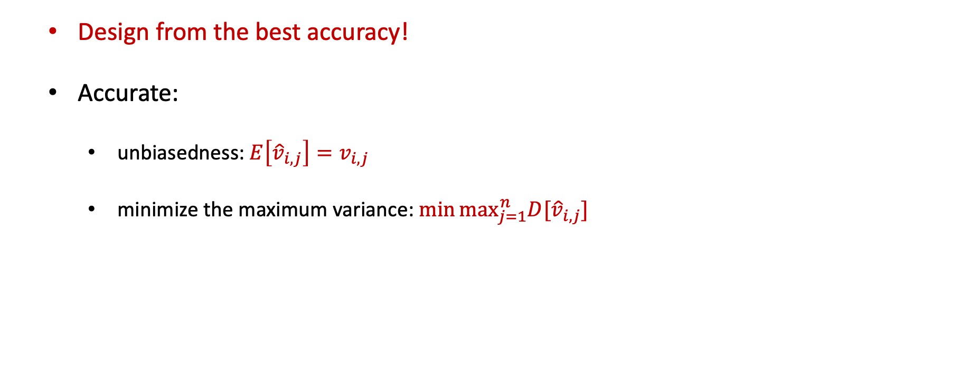
MinMax Sampling: Unbiased & Minimize the Maximum Variance
Design from the best accuracy!
Accurate:
unbiasedness: $E\left[{\hat{v}}_{i,j}\right]=v_{i, j}$
minimize the maximum variance: $min⁡\max_{j=1}^{n}D[{\hat{v}}_{i, j}]$
Notes:
We make two requirements on the sampling to achieve optimal accuracy. The first is that the sampling should be unbiased. For any value, the expectation of the estimated value has to be the same as the true value. The error of the unbiased sampling grows sub-linearly, and is lower than that of the biased sampling;
the second is that for each device, the sampling should minimize the maximum variance of all estimated values. Since we lack knowledge about the distribution of global values, we must guarantee fairness among local values, and minimizing the maximum variance can achieve this.

Slide 17
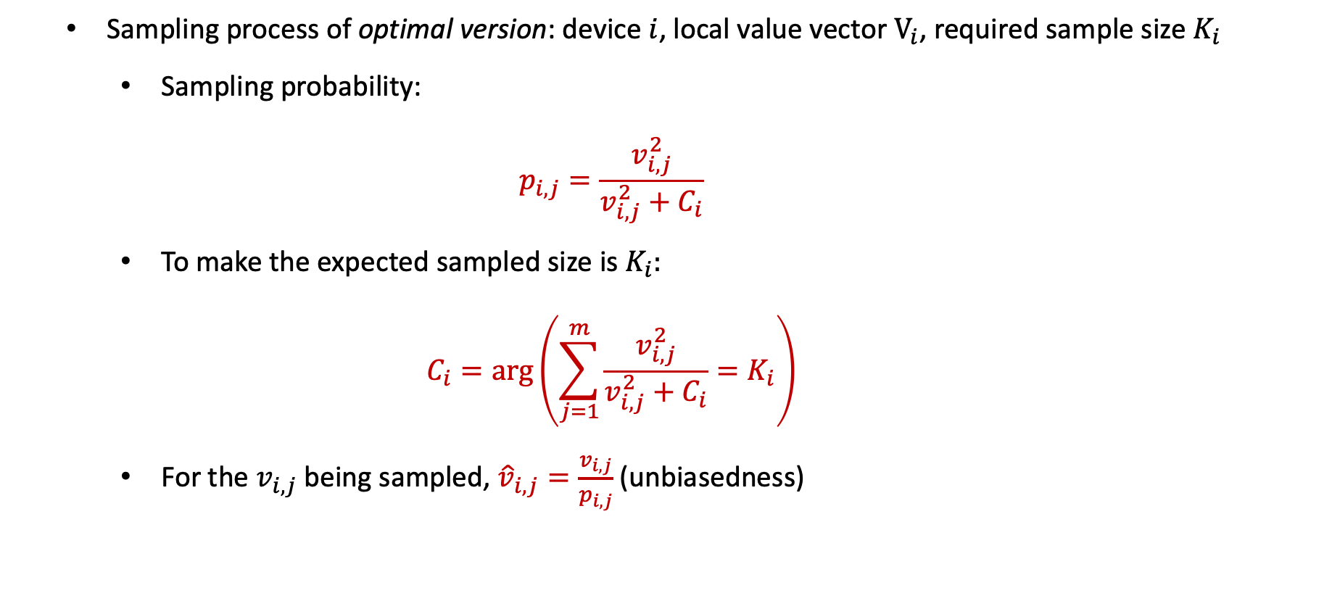
MinMax Sampling: Optimal Version
Sampling process of optimal version: device $i$, local value vector $V_{i}$, required sample size $K_{i}$
Sampling probability:
$$p_{i,j}=\frac{v_{i,j}^{2}}{v_{i,j}^{2}+C_{i}}$$
To make the expected sampled size is $K_{i}$:
$$C_{i}=\arg\left(\sum_{j=1}^{m}{\frac{v_{i,j}^{2}}{v_{i,j}^{2}+C_{i}}}=K_{i}\right)$$
For the $v_{i,j}$being sampled, ${\hat{v}}_{i,j}=\frac{v_{i,j}}{p_{i,j}}$ (unbiasedness)
Notes:
We present here the optimal version of MinMax sampling: at each device, given a vector Vi and an expected number of samples Ki, we assign a sampling probability pij to each value as shown in the formula. To make the expected number of samples equal to Ki, we set Ci to be the solution of the equation in the slide.
The optimal version samples each value independently, and for each value sampled, we set its estimated value to vij divided by pij to achieve unbiasedness. We prove that the maximum variance of the optimal version is the smallest among all unbiased sampling.

Slide 18
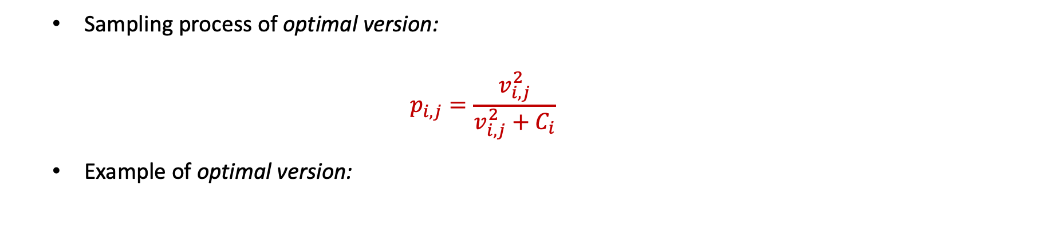
MinMax Sampling: Example of Optimal Version
Sampling process of optimal version:
$$p_{i,j}=\frac{v_{i,j}^{2}}{v_{i,j}^{2}+C_{i}}$$
Example of optimal version:
Notes:
I describe the process of the optimal version with an example. Suppose that the state of a device consists of 6 values, from which we expect to sample 3 values. We solve the equation to obtain the Ci as 0.68, and calculate the probability for each value. 6 probabilities range from 97% to 4%.
We sample each value independently and, as shown in the slide, we sample a total of 4 samples.

Slide 19
MinMax Sampling: Other Two Requirements – Fast & Adaptive
Optimal Version
Fast ✗: cost too much on computing C
Adaptive✗
need to predefine the number of samples
can only guarantee the expected number of samples
Computing Time ( ms ) | Finding C | Others | All
MinMax Sampling (optimal version) | 16.47 ( 86 % ) | 2.85 ( 14 % ) | 19.32 ( 100 % )
Notes:
Although the optimal version achieves optimal accuracy, it does not satisfy the remaining design requirements. First, the optimal version takes a long time to compute Ci, because solving the equation requires a nonlinear algorithm such as the binary search. The time consumption for calculating Ci accounts for 86% of the whole process;
second, not only do we need to predefine the number of samples before the process, we can also only guarantee the expected number. As shown in the figure, although we expect to sample 100 samples, the most unfortunate device will sample 30% more.

Slide 20
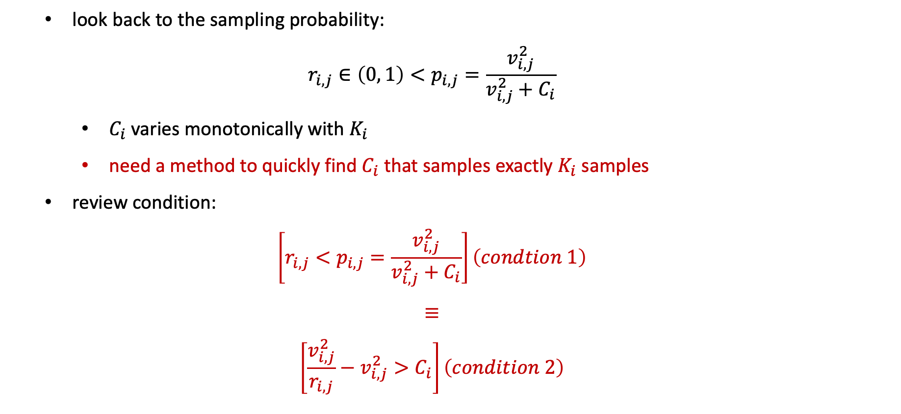
MinMax Sampling: Quickly Find$C$that Samples Exactly $K$Samples
look back to the sampling probability:
$$r_{i,j}∈\left(0, 1\right)<p_{i,j}=\frac{v_{i,j}^{2}}{v_{i,j}^{2}+C_{i}}$$
$C_{i}$ varies monotonically with $K_{i}$
need a method to quickly find $C_{i}$ that samples exactly $K_{i}$ samples
review condition:
$$\left[r_{i,j}<p_{i,j}=\frac{v_{i,j}^{2}}{v_{i,j}^{2}+C_{i}}\right]\left(condtion 1\right)$$
$$≡$$
$$\left[\frac{v_{i,j}^{2}}{r_{i,j}}−v_{i,j}^{2}>C_{i}\right]\left(condition 2\right)$$
Notes:
To find a fast scheme to obtain Ci, we recall the sampling probability. First, we find that Ci varies monotonically with the requested number of samples. Second, after obtaining a probability, we need to generate a random number rij, and compare it with the probability pij.
By deformation, we find that condition 1 and condition 2 are equivalent. Observing condition 2, we find that the larger the term to the right of the greater than sign, the larger probability the value should be sampled.

Slide 21
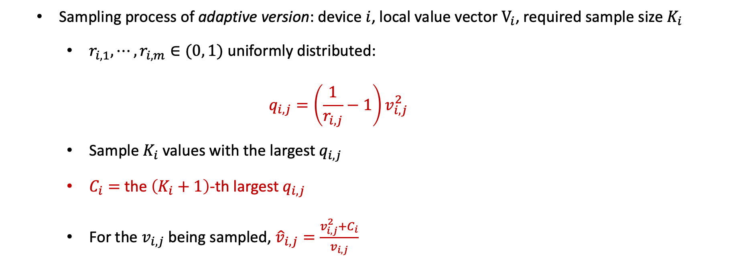
MinMax Sampling: Adaptive Version
Sampling process of adaptive version: device $i$, local value vector $V_{i}$, required sample size $K_{i}$
$r_{i,1}, ⋯,r_{i, m}∈(0, 1)$ uniformly distributed:
$$q_{i,j}=\left(\frac{1}{r_{i,j}}−1\right)v_{i,j}^{2}$$
Sample $K_{i}$ values with the largest $q_{i,j}$
$C_{i}=$ the $\left(K_{i}+1\right)$-th largest $q_{i,j}$
For the $v_{i,j}$being sampled, ${\hat{v}}_{i,j}=\frac{v_{i,j}^{2}+C_{i}}{v_{i,j}}$
Notes:
Based on the observations, we propose the adaptive version of MinMax sampling: at each device, we generate random numbers between 0 and 1, and assign each value a priority qij as in the formula. we sample the local values with the largest Ki priorities, and set Ci to the (Ki+1)-th largest priority.
We demonstrate that the sampling can be unbiased by setting the estimated value of the sampled values according to the formula in the slide.

Slide 22
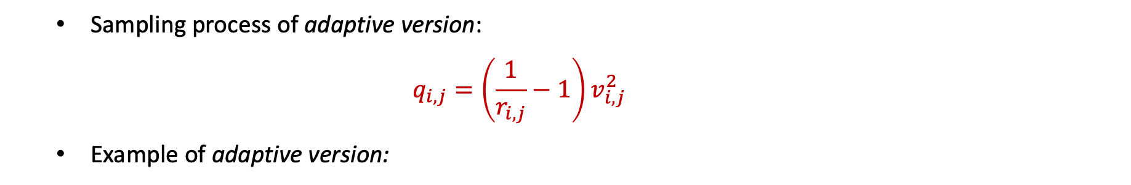
MinMax Sampling: Example of Adaptive Version
Sampling process of adaptive version:
$$q_{i,j}=\left(\frac{1}{r_{i,j}}−1\right)v_{i,j}^{2}$$
Example of adaptive version:
Notes:
I use the same example to describe the process of the adaptive version. We generate a random number for each value and calculate its priority. 6 priorities range from 10.2 to 0.01. We set Ci to be the 4th largest priority 0.38, and sample the 3 local values with the largest priority. This time we are bound to sample 3 samples.

Slide 23
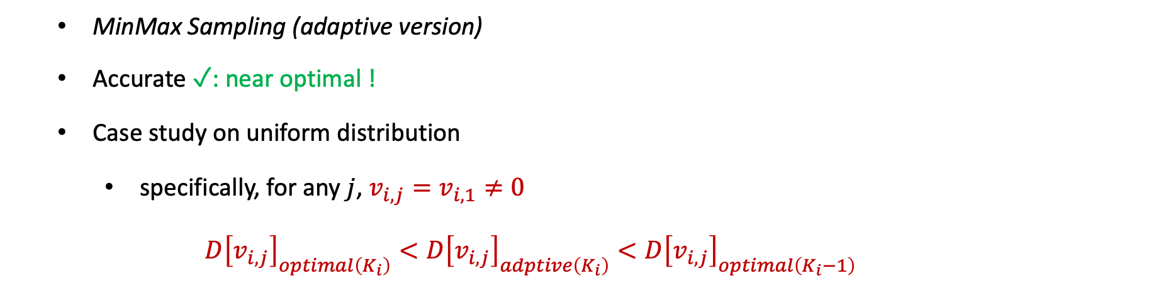
MinMax Sampling: Near-Optimality of Adaptive Version
MinMax Sampling (adaptive version)
Accurate ✓: near optimal !
Case study on uniform distribution
specifically, for any $j$, $v_{i,j}=v_{i,1}≠0$
$$D{\left[v_{i,j}\right]}_{optimal\left(K_{i}\right)}<D{\left[v_{i,j}\right]}_{adptive\left(K_{i}\right)}<D{\left[v_{i,j}\right]}_{optimal\left(K_{i}−1\right)}$$
Notes:
The adaptive version still achieves near-optimal accuracy. Theoretically, if all values are the same, the variance of the adaptive version of Ki samples is less than that of the optimal version of Ki-1 samples.

Slide 24
MinMax Sampling: Optimal Version v.s. Adaptive Version in the Real Dataset
MinMax Sampling (adaptive version)
Accurate ✓: near optimal !
Comparison in the real dataset
Minmax Sampling (optimal version) v.s. Minmax Sampling (adaptive version)
Notes:
For real data, as shown in the slide, we verify that the difference between the variance of the optimal and adaptive versions is less than 0.05% in all cases.

Slide 25
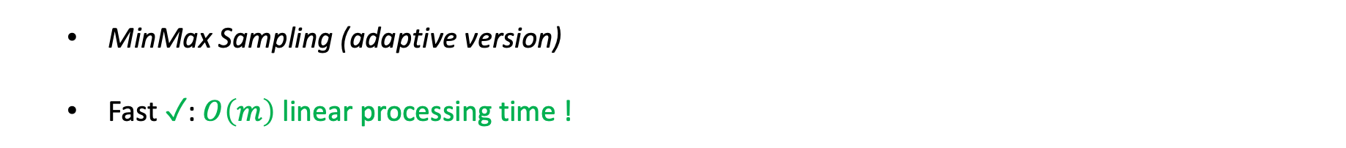
MinMax Sampling: Linear Processing Time
MinMax Sampling (adaptive version)
Fast ✓: $O\left(m\right)$ linear processing time !
Computing Time ( ms ) | Finding C | Others | All
MinMax Sampling (optimal version) | 16.47 ( 86 % ) | 2.85 ( 14 % ) | 19.32 ( 100 % )
MinMax Sampling (adaptive version) | 0.96 ( 22 % ) | 3.44 ( 78 % ) | 4.40 ( 100 % )
Notes:
The adaptive version achieves fast computation. Since the process of calculating priorities and finding the K-th largest priority are both linear in time, the adaptive version saves 77% of the computation time compared to the optimal version.

Slide 26
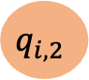
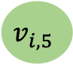
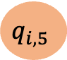
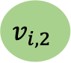
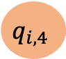
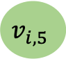
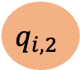
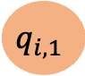
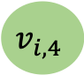
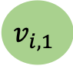
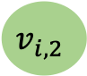
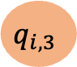
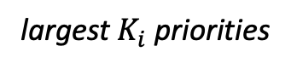
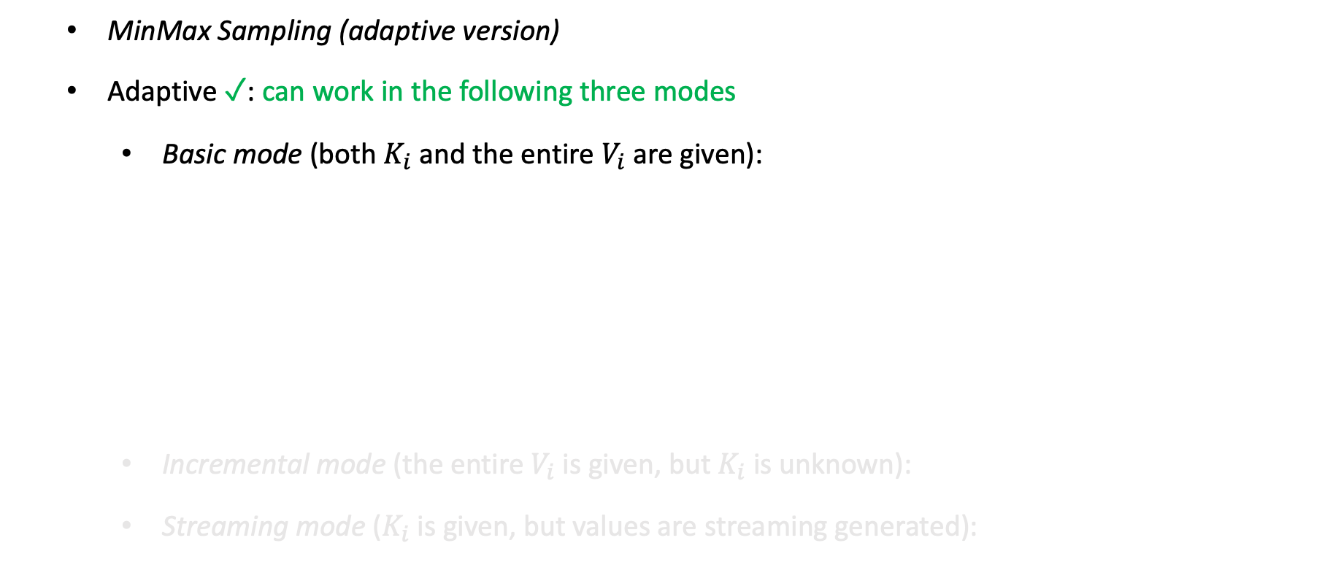


MinMax Sampling: Three Working Models – Basic, Incremental, Streaming
MinMax Sampling (adaptive version)
Adaptive ✓: can work in the following three modes
Basic mode (both $K_{i}$ and the entire $V_{i}$ are given):
Incremental mode (the entire $V_{i}$ is given, but $K_{i}$ is unknown):
Streaming mode ($K_{i}$ is given, but values are streaming generated):
$$v_{i,1}$$
$$v_{i,2}$$
$$v_{i,3}$$
$$v_{i,4}$$
$$v_{i,5}$$
largest $K_{i}$ priorities
$$v_{i,2}$$
$$v_{i,5}$$
network
$$q_{i,1}$$
$$q_{i,2}$$
$$q_{i,3}$$
$$q_{i,4}$$
$$q_{i,5}$$
$$q_{i,2}$$
$$q_{i,5}$$
Notes:
Finally, the adaptive version enables adaptive transmission. The adaptive version supports 3 different modes. When we know the entire vector Vi and the exact number of samples Ki, we use the basic mode described before;

Slide 27





















MinMax Sampling: Three Working Models – Basic, Incremental, Streaming
MinMax Sampling (adaptive version)
Adaptive ✓: can work in the following three modes
Basic mode (both $K_{i}$ and the entire $V_{i}$ are given):
Incremental mode (the entire $V_{i}$ is given, but $K_{i}$ is unknown):
Streaming mode ($K_{i}$ is given, but values are streaming generated):
$$v_{i,1}$$
$$v_{i,2}$$
$$v_{i,3}$$
$$v_{i,4}$$
$$v_{i,5}$$
sort by priority
$$v_{i,2}$$
$$v_{i,5}$$
$$v_{i,3}$$
$$v_{i,1}$$
$$v_{i,4}$$
network
$$q_{i,1}$$
$$q_{i,2}$$
$$q_{i,3}$$
$$q_{i,4}$$
$$q_{i,5}$$
$$q_{i,2}$$
$$q_{i,5}$$
$$q_{i,3}$$
$$q_{i,1}$$
$$q_{i,4}$$
Notes:
when we only know Vi, but Ki needs to be dynamically adjusted, we use the incremental mode. We sort all the values according to the priorities, and transmit the values from largest to smallest according to priority. Unbiasedness is achieved by taking the largest priority not transmitted as Ci;

Slide 28

















MinMax Sampling: Three Working Models – Basic, Incremental, Streaming
MinMax Sampling (adaptive version)
Adaptive ✓: can work in the following three modes
Basic mode (both $K_{i}$ and the entire $V_{i}$ are given):
Incremental mode (the entire $V_{i}$ is given, but $K_{i}$ is unknown):
Streaming mode ($K_{i}$ is given, but values are streaming generated):
$$v_{i,4}$$
$$v_{i,1}$$
$$v_{i,2}$$
$$v_{i,3}$$
$$v_{i,4}$$
$$v_{i,5}$$
min-heap of size $K_{i}$
$$v_{i,1}$$
$$v_{i,3}$$
network
$$q_{i,1}$$
$$q_{i,2}$$
$$q_{i,3}$$
$$q_{i,4}$$
$$q_{i,5}$$
$$v_{i,5}$$
$$v_{i,2}$$
Notes:
we use streaming mode when values are streaming generated. We maintain a heap containing Ki+1 values according to the priorities, transmit the Ki values with the largest priorities in the heap at the end of the stream, and use the smallest priority in the heap as Ci.

Slide 29
MinMax Sampling: Outlier Elimination & Verification
Outlier Elimination
filter outliers based on the idea of hypothesis testing
assume that the estimated sum is totally accurate
Verification of outlier elimination
Notes:
In addition, since random sampling may introduce large errors for a very small number of global values, we also propose an algorithm for outlier elimination based on hypothesis testing. We verify that this algorithm can significantly reduce the extreme errors.

Slide 30

03
Part Three
Experiments
Notes:
I will then briefly show the results of some representative experiments.

Slide 31

Experiments Setup - Federated Learning
Federated Learning
Datasets: CIFAR-10
CIFAR-10 is an image classification dataset.
$60,000$ $32×32$ color images in $10$ classes, $50,000$ training images and 10,000 test images
We use Resnet9 on CIFAR-10, which contains $6.5M$ parameters.
Settings | i.i.d / non-i.i.d | # workers | participating rate | local batch size
Small-scale FL | non-i.i.d | 200 | 5% | 50
Large-scale FL | non-i.i.d | 2000 | 1% | 25
Distributed ML | i.i.d | 10 | 100% | 50
Notes:
The experiment consists of two parts, the first part evaluates the performance of our scheme for federated learning. We use the CIFAR-10 image dataset, using ResNet-9 as the model. Our experiments contain three settings: small-scale federated learning, large-scale federated learning, and distributed machine learning.
The specific settings are shown in the table.

Slide 32
Experiments on Federated Learning
Small-scale FL
Large-scale FL
Distributed ML
Notes:
Our scheme outperforms the comparison schemes, including FetchSGD, GSpar, and the Top-K sampling, in both federated learning settings. The advantage of our scheme becomes more obvious at high compression ratios.
In the distributed machine learning setting, the consideration of fairness cannot bring significant advantages because the training data are IID, so our scheme and GSpar have similar performance.

Slide 33

Experiments Setup - Distributed State Aggregation & Hierarchical Aggregation
Distributed State Aggregation & Hierarchical Aggregation
Datasets: CAIDA
We use the traffic dataset collected from CAIDA in 2018. Each packet is associated with a 5-tuple (<srcIP, dstIP, srcPort, dstPort, protocol>).
i.i.d: randomly allocate each packet to one device
Count the number of each srcIP
Each local device contains $1.81×{10}^{5}$srcIP on average.
non-i.i.d: hash each packet to one device according to its 5-tuple
Count the number of each srcIP
Each local device contains $4.93×{10}^{4}$ srcIP on average.
Notes:
The second part evaluates the performance of our scheme for distributed state aggregation and hierarchical aggregation. We use the CAIDA network dataset and construct both IID and non-IID datasets.

Slide 34
Experiments on Distributed State Aggregation
Estimating global frequency
Finding global top-𝐾
Notes:
We evaluate two important tasks in distributed state aggregation, estimating global frequencies and finding globally frequent items. Experimental results show that our scheme outperforms the comparison algorithms, including the Top-K sampling, the unbiased IceBerg sampling, and the count sketch-based scheme.

Slide 35
Experiments on Hierarchical Aggregation
Estimating global frequency
Finding global top-𝐾
Notes:
We evaluate both tasks in hierarchical aggregation as well. The experimental results show that our algorithm still exhibits advantages.

Slide 36
04
Part Four
Summary
Notes:
Finally, I conclude with a summary of our contributions.

Slide 37

Conclusion
We propose MinMax Sampling, a communication scheme for global aggregation in the WAN.
MinMax_{opt} achieves optimal accuracy.
MinMax_{adp} meets all three requirements of designing a communication scheme: 1) Fast computation. 2) Adaptive transmission. 3) Near-optimal accuracy.
We evaluate MinMax_{adp} with three applications: 1) Federated learning. 2) Distributed state aggregation. 3) Hierarchical aggregation.
MinMax_{adp} is superior to existing algorithms in all three applications.
Its accuracy is $8.44×$ higher on average.
Accurate global aggregation can help improve the accuracy of FL by up to $7.73\%$.
The source codes of MinMax Sampling are available at GitHub.
E-mail: zyk@pku.edu.cn
Notes:
We propose MinMax sampling, a communication scheme for global aggregation, whose optimal version achieves optimal accuracy, while the adaptive version satisfies all three design requirements;

Slide 38

Conclusion
We propose MinMax Sampling, a communication scheme for global aggregation in the WAN.
MinMax_{opt} achieves optimal accuracy.
MinMax_{adp} meets all three requirements of designing a communication scheme: 1) Fast computation. 2) Adaptive transmission. 3) Near-optimal accuracy.
We evaluate MinMax_{adp} with three applications: 1) Federated learning. 2) Distributed state aggregation. 3) Hierarchical aggregation.
MinMax_{adp} is superior to existing algorithms in all three applications.
Its accuracy is $8.44×$ higher on average.
Accurate global aggregation can help improve the accuracy of FL by up to $7.73\%$.
The source codes of MinMax Sampling are available at GitHub.
E-mail: zyk@pku.edu.cn
Notes:
we evaluate the performance of MinMax sampling in three different scenarios; the experimental results show that our scheme outperforms existing algorithms in all three scenarios, which is reflected in the improvement of the accuracy of aggregation and the accuracy of training for federated learning.

Slide 39

Conclusion
We propose MinMax Sampling, a communication scheme for global aggregation in the WAN.
MinMax_{opt} achieves optimal accuracy.
MinMax_{adp} meets all three requirements of designing a communication scheme: 1) Fast computation. 2) Adaptive transmission. 3) Near-optimal accuracy.
We evaluate MinMax_{adp} with three applications: 1) Federated learning. 2) Distributed state aggregation. 3) Hierarchical aggregation.
MinMax_{adp} is superior to existing algorithms in all three applications.
Its accuracy is $8.44×$ higher on average.
Accurate global aggregation can help improve the accuracy of FL by up to $7.73\%$.
The source codes of MinMax Sampling are available at GitHub.
E-mail: zyk@pku.edu.cn
Notes:
Thank you all, my presentation is now over.

